Slide 1
Predicting University Admission using Regression Analysis
DS6372: Project 1
Joe Schueder, Anthony Egbuniwe, Che Cobb

Slide 2
Agenda
Introduction
Dataset and Data Collection Process
Exploratory Data Analysis
Model refinement with Variable Selection Techniques
LASSO, Forward Selection, Stepwise Selection
Conclusions

Slide 3
Introduction
Graduate Admissions to US Schools for Indian Candidates
Every year almost a hundred thousand international students from India apply to American universities for admission to graduate study
The decision of whether to admit a student into U. S. graduate programs is an important challenge for both the students and universities
Most admission procedures involve the rank ordering of students with top-down selection based on TOEFL or GRE scores and College GPA
For Universities, having the ability to predict the success of students when they enter a graduate program is critical in promoting the success of their program.

Slide 4
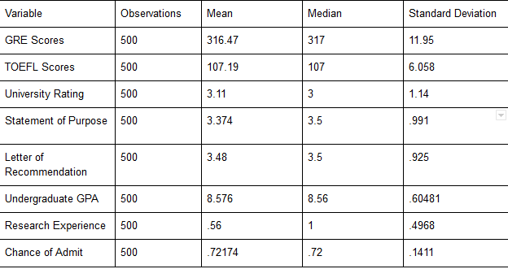
Dataset and Collection Process
This dataset is created for prediction of graduate admissions and the dataset link is below:
https://www.kaggle.com/mohansacharya/graduate-admissions
GRE Scores (290 to 340)
TOEFL Scores (92 to 120)
University Rating (1 to 5)
Statement of Purpose (1 to 5)
Letter of Recommendation Strength (1 to 5)
Undergraduate GPA (6.8 to 9.92)
Research Experience (0 or 1)
Chance of Admit (0.34 to 0.97)

Slide 5
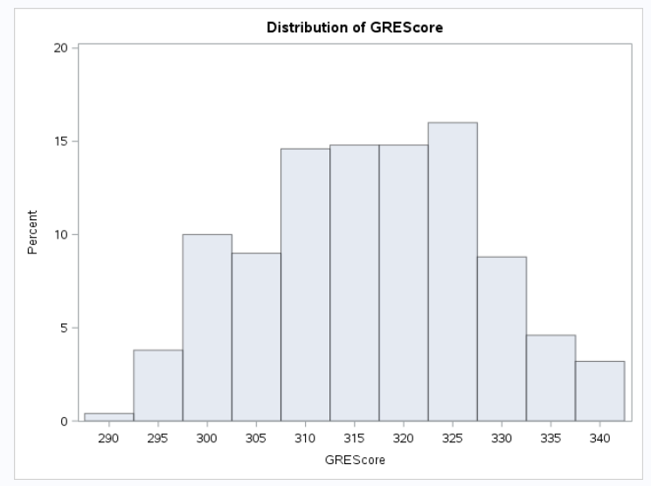
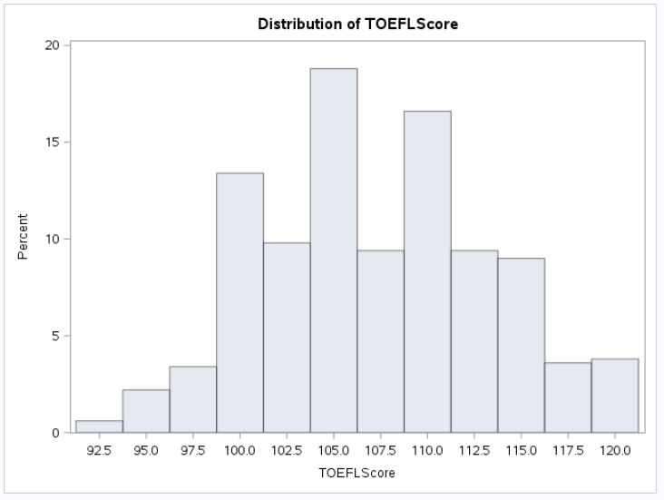
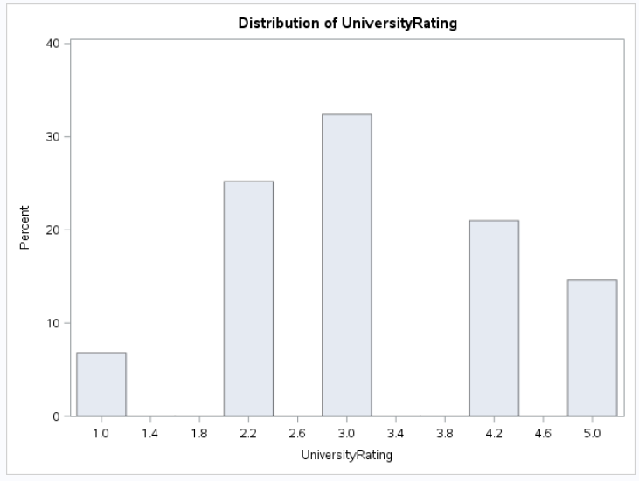
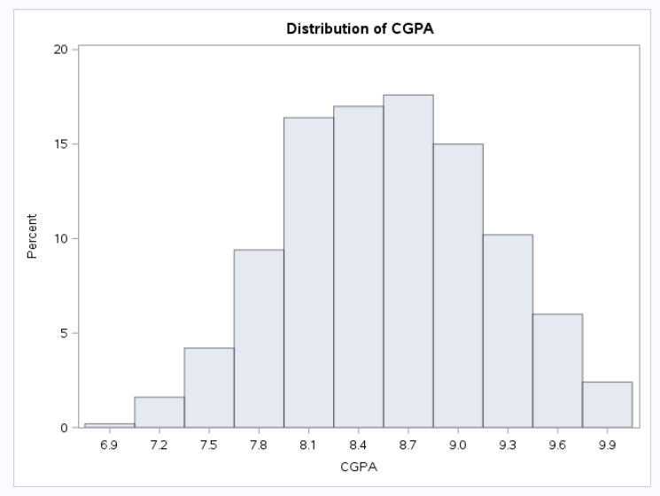
Exploratory Data Analysis | Output Variables
GRE Scores, TOEFL Scores, University Rating, GPA are continuous numeric variables with a somewhat normal looking distributions.

Slide 6
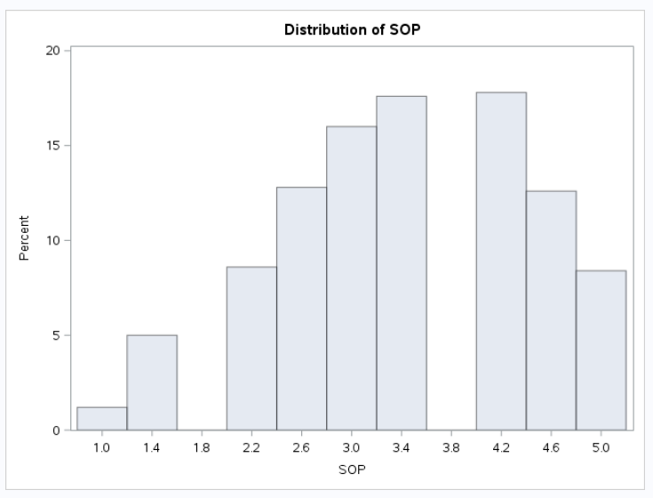
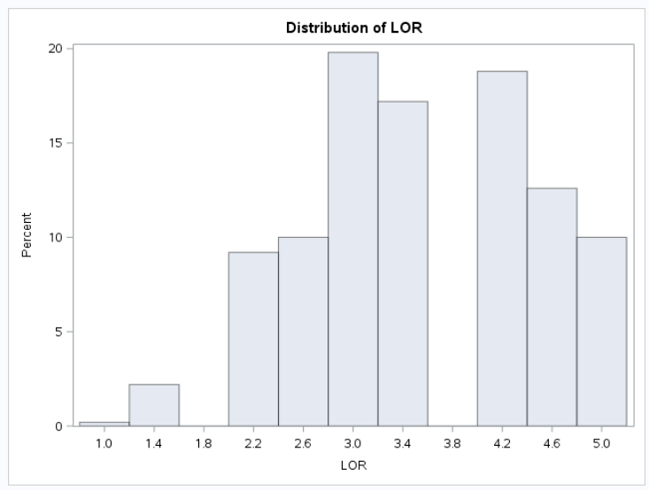
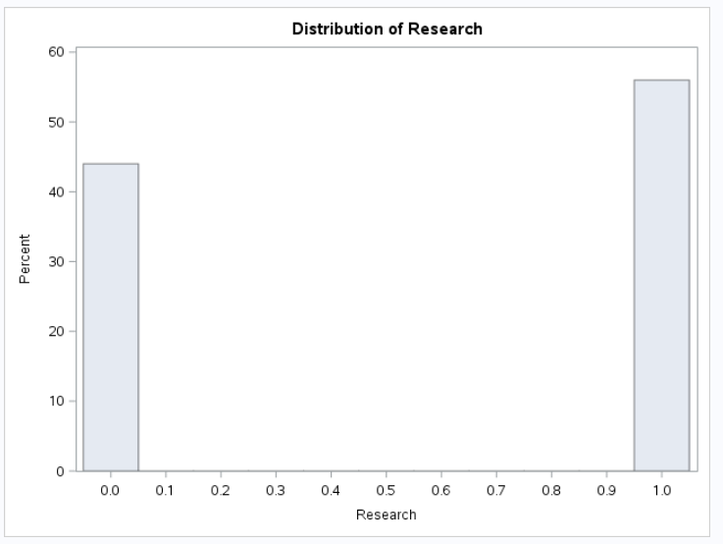
Exploratory Data Analysis | Output Variables (2)
2. Statement of Purpose & Letter of Recommendation are continuous numeric also, though slightly left skewed. Research is a yes, no variable represented by 0 and 1.

Slide 7
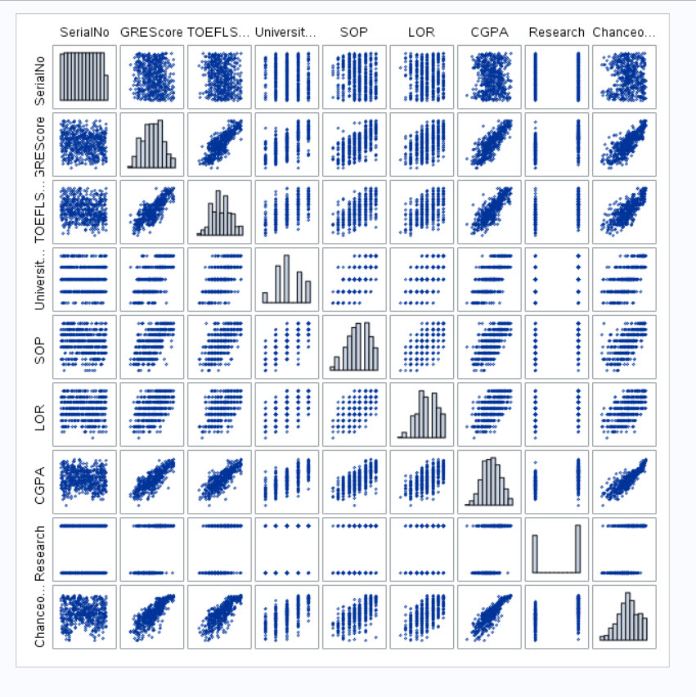
Exploratory Data Analysis | Scatter Plots
An exploratory analysis was done to check the relationships between the variables contained in the data.
Many of the variables have linear relationships with each other
For all these relationships the relationship is positive: as one increases, so does the other.

Slide 8
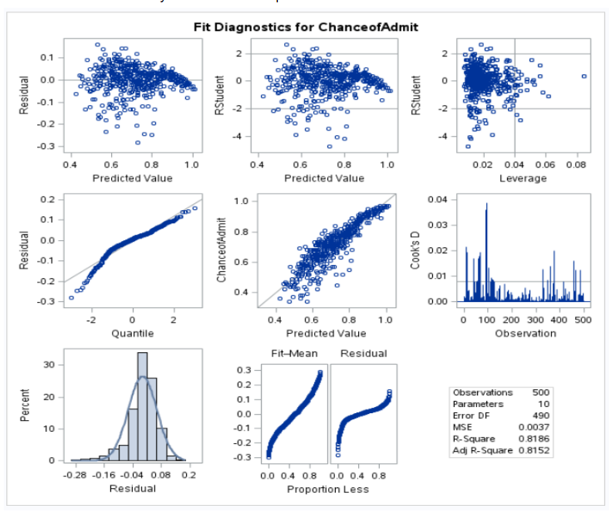
Variable Selection Process
Try various variable selection techniques
Forward Selection
Stepwise Selection
LASSO
Compare fit statistics and performance on test set
Residual Analysis
Pick best model

Slide 9
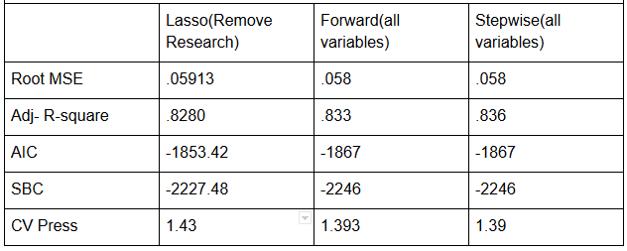
Variable Selection Comparison
All have closely matching statistics, predictor variables and estimates.
LASSO ran with Research Removed
Forward and Stepwise ran with all variables
Best Model: Lasso chose the most accurate model based on CV press with the least number of predictors.

Slide 10
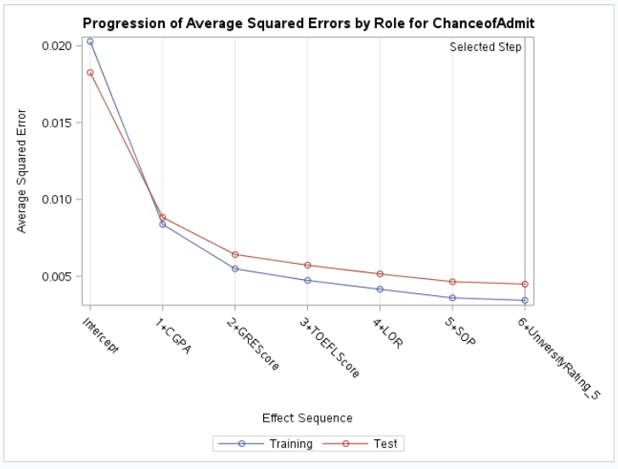
Best Model |
We can see the addition of variables at each step and the growth of the coefficients from the coefficient progression curve
It can be observed that the effect on prediction error increase as the model grows more complex

Slide 11
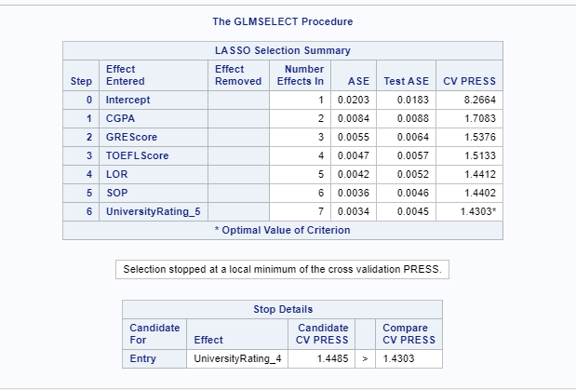
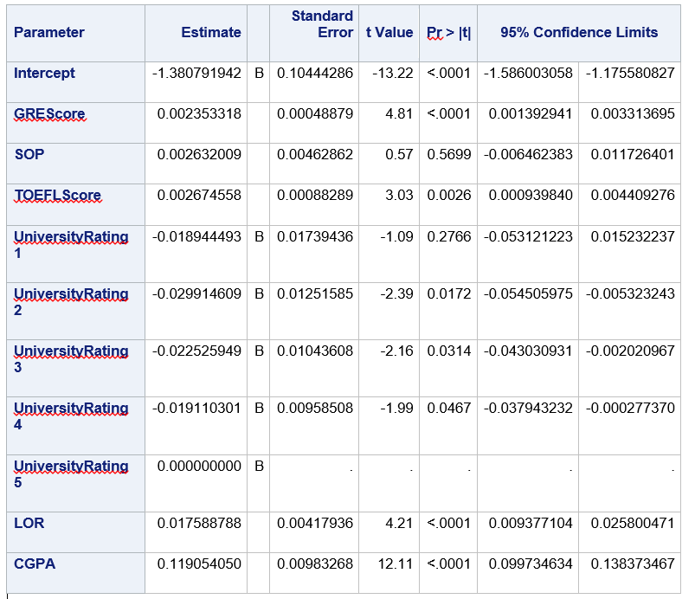
Best Model | Variables, Coefficients, Confidence Intervals
CGPA, GREScore & TOEFLScore showed the maximum correlation in predicting the target variable of Chance of Admit.

Slide 12
Best Model | Inference and Conclusion
Per the website College Countdown, the student should only consider applying to a school if their chance of admittance is greater than 50% and a ‘sure thing’ acceptance to be greater than a 75% chance.
If the student has a limited amount of resources for application fees, they should only consider applying to those schools with at least a 50% chance of admittance, but even better to apply for those with a 75% chance of admittance or higher.
A student with a GRE score of 298, TOEFL of 98, University Ranking of 2, SOP 1.5, LOR of 2.5, and CGPA of 7.5 has a predicted chance of admittance of .49 so they may want to be very selective about which schools they apply.
A person with GRE of 328, TOEFL of 119, University Rating of 5, SOP of 5, and LOR of 4.5, and CGPA of 9.7 has a chance of admittance of .97 and can reasonably expect to be accepted to most schools they apply.
Since this dataset is limited to the Indian student perspective, we must limit the inference gained from this study to only the subjects of this sample.

